Slide 1


The global agenda of lldcs for the implementation of rights under international law
Franz Zubieta Mariscal
UN - OHRLLS

Slide 2
4 Key Facts to Enhance
Implementation of Rights:
Who are the LLDCs?
Awaza Program of Action
Thematic Agendas of the LLDCs Group
Pathways for Implementation of Rights

Slide 3
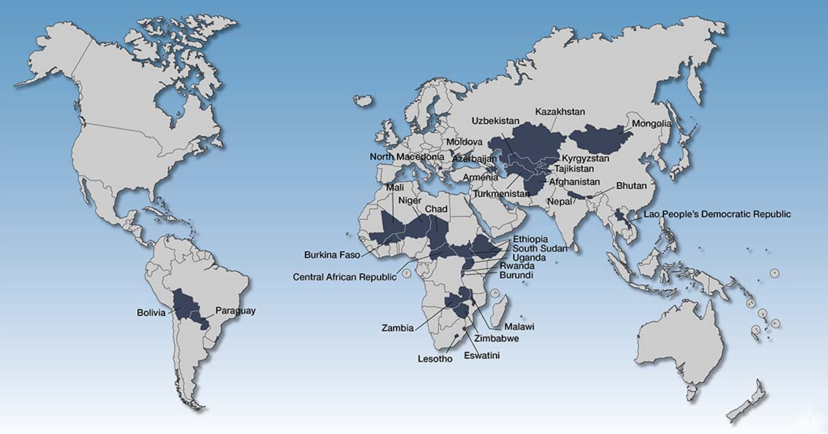
1
Who are the LLDCs?
Geo-structural Disability
Total landlocked states worldwide: 43
LLDCs: 32 recognised by the UN
Heterogeneous Group:
  16 in Africa
  10 in Asia
  2 in Eastern Europe
  2 in Latin America
Source: UNCTAD 2026

Slide 4
LLDCs face distinct geographic and structural constraints to development
The disadvantage is cumulative and cause-effect driven:
NO DIRECT
SEA ACCESS
TRANSIT
DEPENDENCE
TIME, COST &
UNCERTAINTY
LOWER
COMPETITIVENESS
CONSTRAINED
TRANSFORMATION
34 days
+63%
+75%
82%
-19%
Time for goods to get from arrival port to delivery on average
Export logistics costs vs coastal peers
Import logistics costs vs transit peers
Exports concentrated in primary commodities
Lower scores on Human Development Indexes

Slide 5
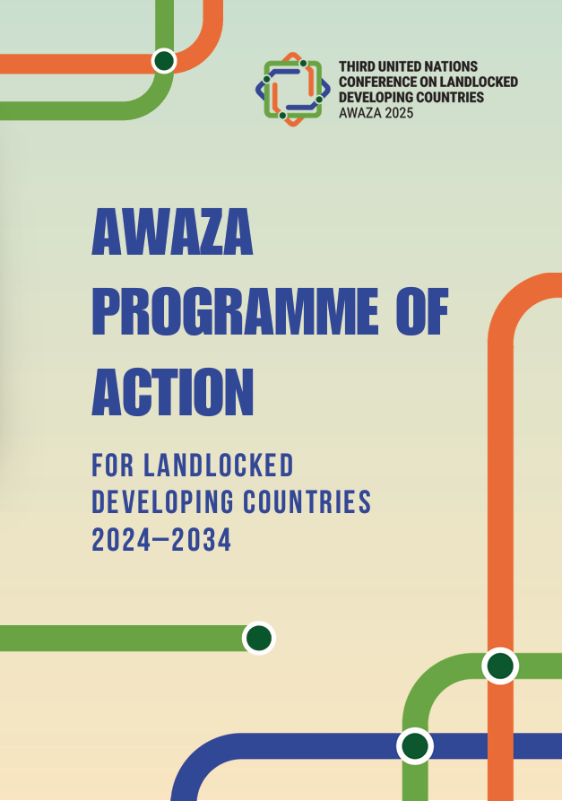
2
1
193 MEMBER STATES
Commitments by all member states including development partners, transit countries and LLDCs
Formally negotiated through 40 intersessional, paragraph-by-paragraph reading, and committee sessions
2
NEGOTIATED
3
CONSENSUS
Embodies agreement from all member states, without need for a vote
4
LEGITIMACY
A principled multilateral recognition of LLDC challenges and solutions in ‘agreed language’, reflecting solidified UN policy

Slide 6
One integrated agenda. Five mutually reinforcing priorities. Multiple linkages.
01
02
03
04
05
Structural transformation
Trade and regional integration
Transit, transport and connectivity
Resilience
Means of implementation
Science, technology, innovation and productive capacities
Trade facilitation, diversification and value chains
Physical, digital and energy connectivity
Climate adaptation and disaster-risk reduction
Finance, partnerships, capacity and technology
Multiple Linkages with the International Agenda NOT A SELF-CONTAINED REGIME
Notes:
For the final slide on the “what” of the APoA, let me share a brief overview of the 5 priority areas of the Programme

Slide 7

3
Thematic Agendas of LLDCs
HLPFoT
The first UN mechanism to systematically examine the intersection of the law of the sea and international trade law: UNCLOS, GATT, WTO, etc.
1
2
UNFCCC
BBNJ
The Convention’s draft regulatory framework now provides a permanent seat for LLDC on all subsidiary bodies, including Technology Transfer, Capacity Building, and Marine Genetic Resources.
3
Transport, Climate Change, Common Heritage of Humankind, and financing, science and technology.
4
Thematic Coordinators
Of the LLDC Group

Slide 8
Pathway for implementation of rights
4
4
Understand the heterogeneous nature of the group (clear entitlement, blue skills, collective action)
Understand the Systemic Nature of LLDCs Global Agenda
Power in Numbers

Slide 9
Muchas gracias
More information: https://www.un.org/ohrlls/content/landlocked-developing-countries
Email: Franz.zubietamariscal@gmail.com
WhatsApp: +44 7825142103

