Slide 1
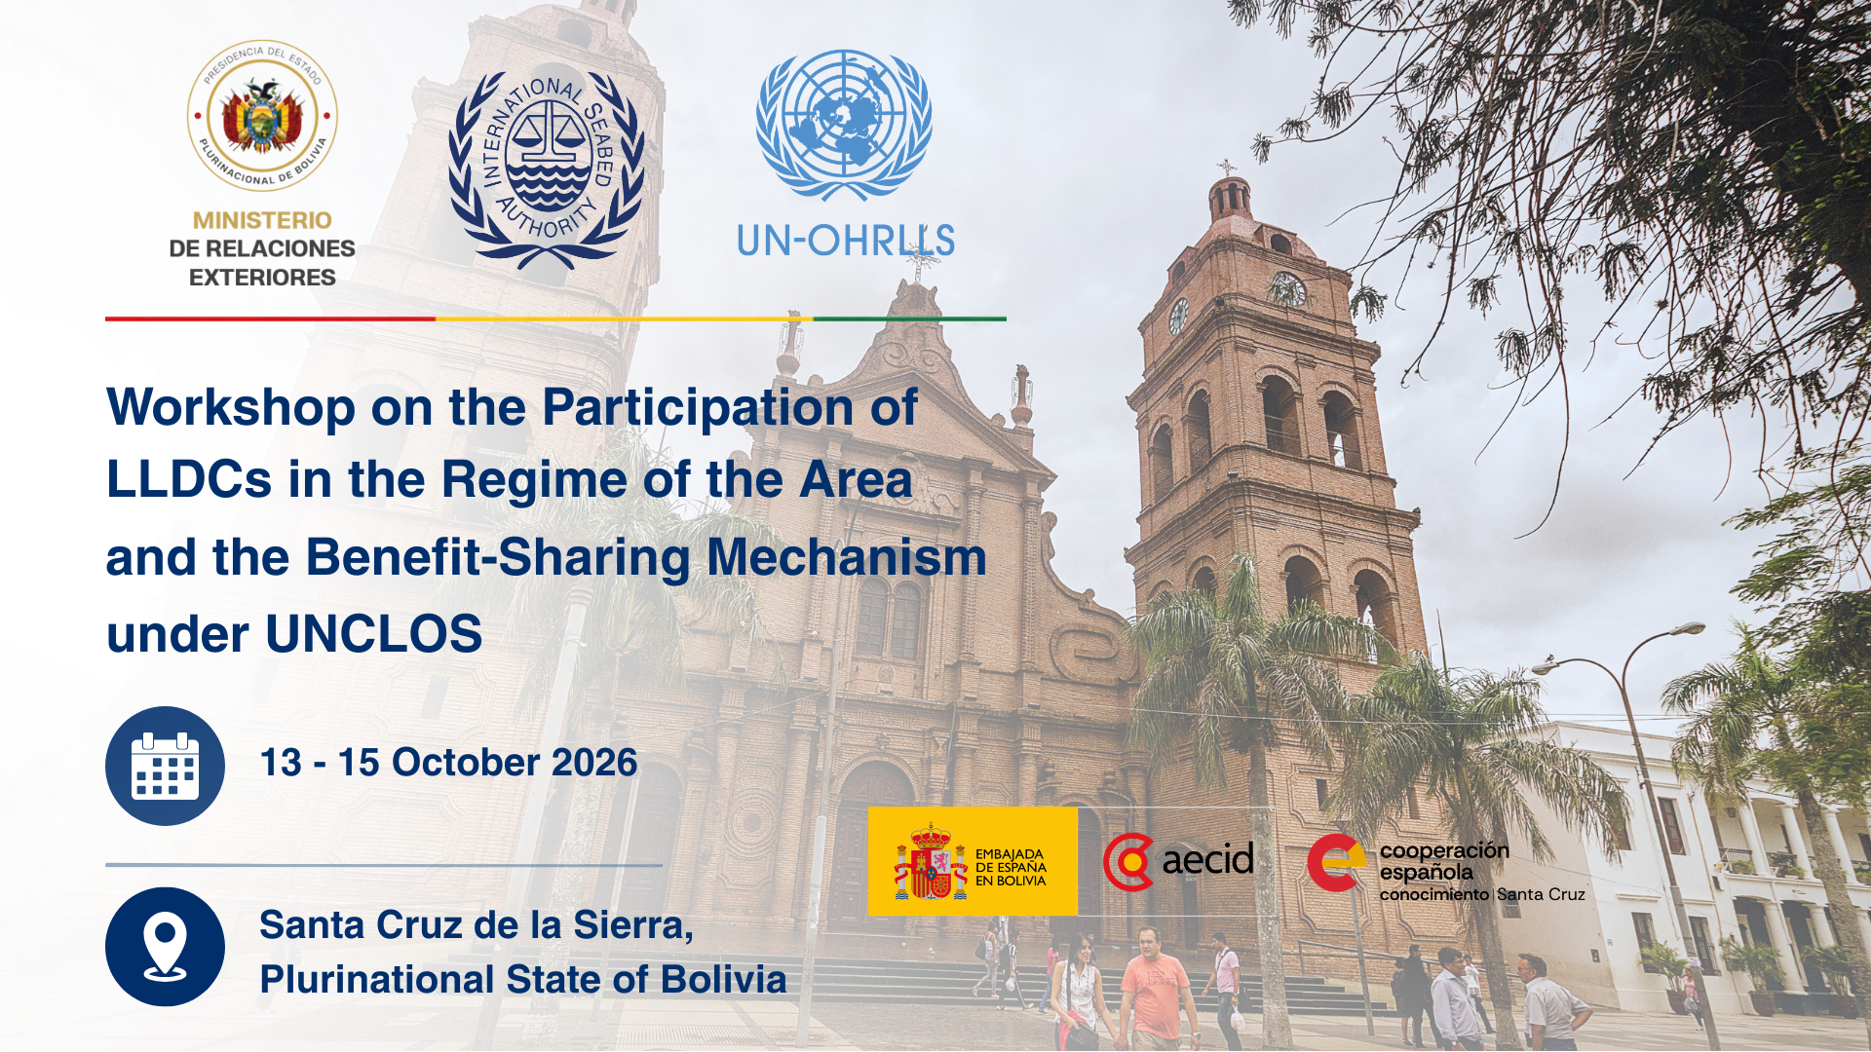

Slide 2




ISA Marine Research Action Plan, Partnership Opportunities
Jose Dallo
ISA Director Environmental Management and Mineral resources
15 October 2026

Slide 3
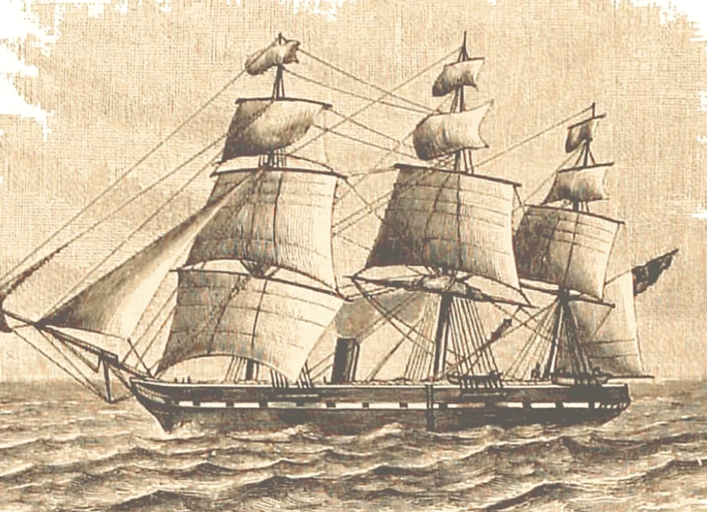
HMS Challenger
A Trailblazer in modern Ocean Science
Notes:
The first scientific expedition to explore the world’s ocean and seafloor was the challenger Expedition in 1872.
Following the entry into force of UNCLOS in 1982 and the establishment of ISA in 1994, prospecting and exploration activities in the seabed on areas beyond national jurisdiction (the Area) began to be internationally regulated, and ISA became the custodian of the data collected by pioneer investors and all other exploration activities in the Area.
Today, ISA is the custodian of over 10 terabytes of data. This represents the largest repository of seabed data in the world.
Environmental data is publicly available through the ISA DeepData Database this includes baseline data such as biological parameters, physical oceanographic parameters and geochemical parameters collected in the Area.

Slide 4
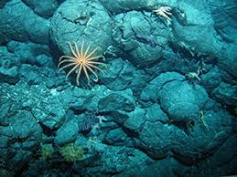
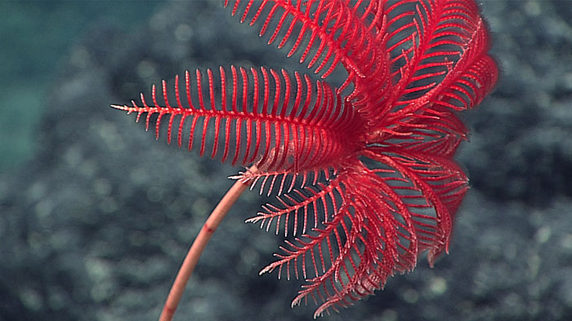
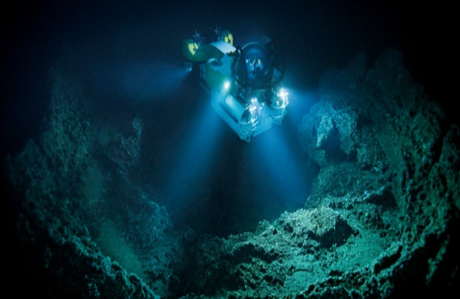
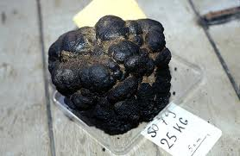
Mandate of ISA
MANAGE
PROTECT
PROMOTE
SHARE
Exploration and Exploitation
Environment and Biodiversity
Marine Scientific Research
Monetary and non-monetary Benefits
The Area is the only example of a global commons that is regulated through a consensus-based international organization for the common benefit
Notes:
ISA is an autonomous international organization established under the 1982 United Nations Convention on the Law of the Sea (UNCLOS) and the 1994 Agreement relating to the Implementation of Part XI of the United Nations Convention on the Law of the Sea (1994 Agreement).
ISA is the organization through which States Parties to UNCLOS organize and control all mineral resources-related activities in the Area for the benefit of mankind.
ISA has the mandate to ensure the effective protection of the marine environment from harmful effects that may arise from deep-seabed related activities, as well as the technology transfer and capacity building, the promotion of marine scientific research, data compilation.
ISA provides a critical platform for knowledge generation on the deep-sea, its resources and ecosystems.

Slide 5
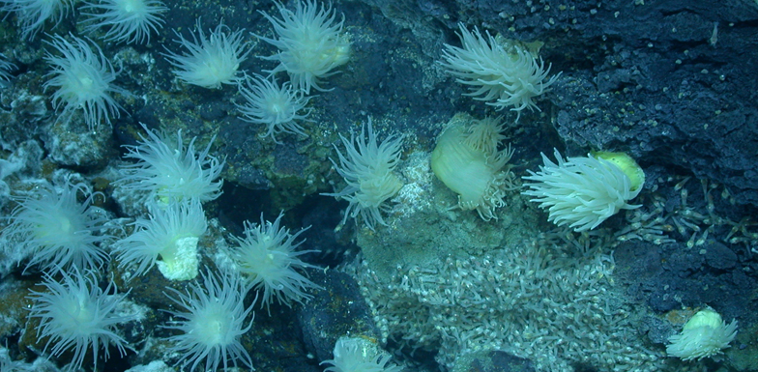

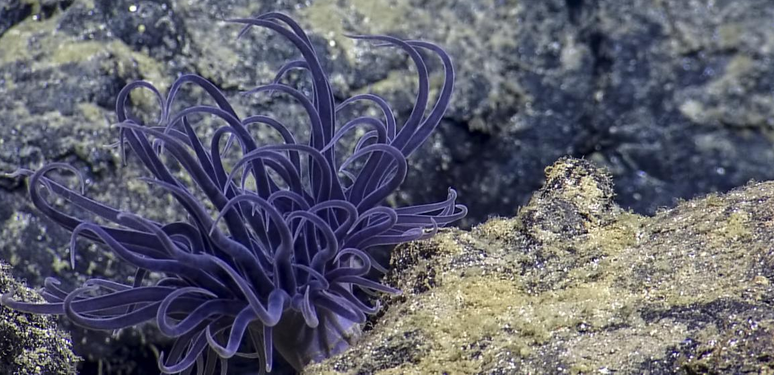
ISA & Marine Scientific Research
ISA shall promote and encourage the conduct of marine scientific research in the Area
ISA shall coordinate and disseminate the results of such research and analysis when available
ISA shall encourage appropriate programmes (…) for the benefit of developing States
UNCLOS, article 143
Notes:
Marine Scientific Research is at the heart of the mandate of protecting the Marine Environment and Article 143 of UNCLOS specifies this.
It mentions the Authority shall
promote and encourage the conduct of marine scientific research in the Area and
coordinate and disseminating the results of such research is at the core of ISA’s mission
Encourage appropriate programmes

Slide 6
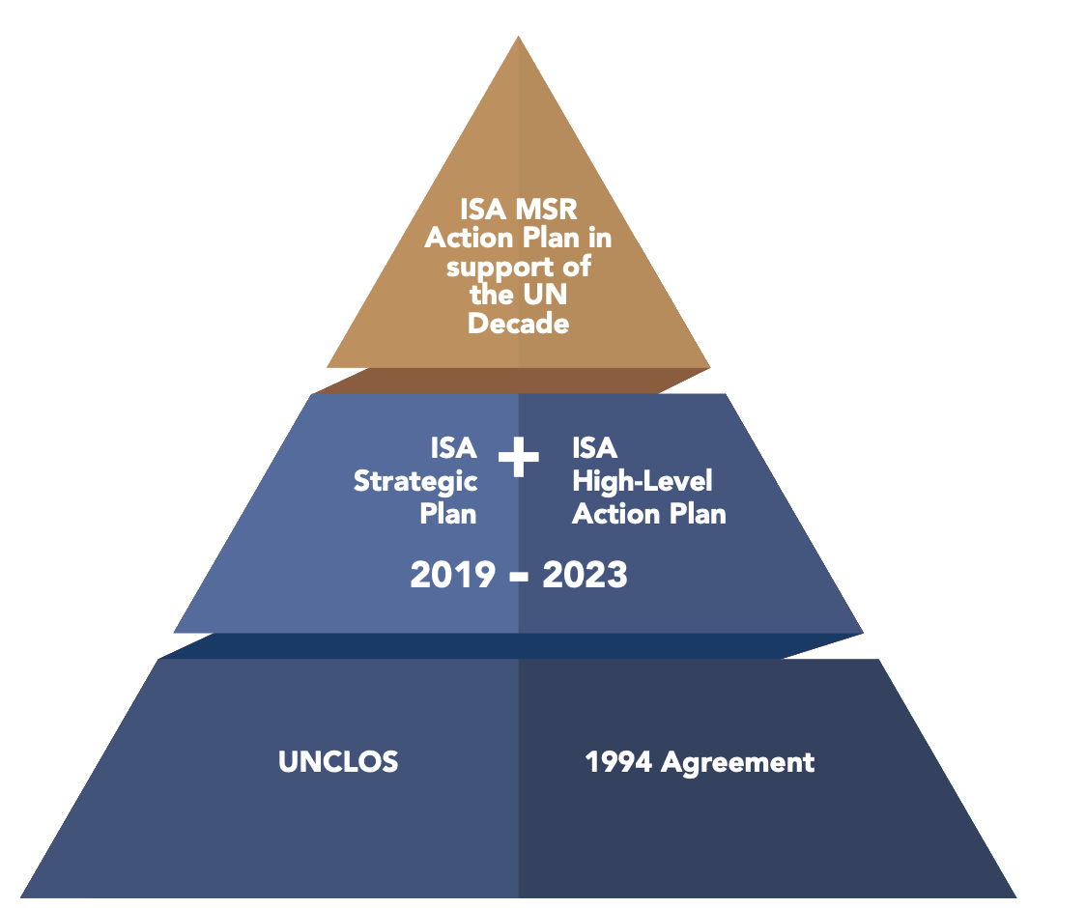
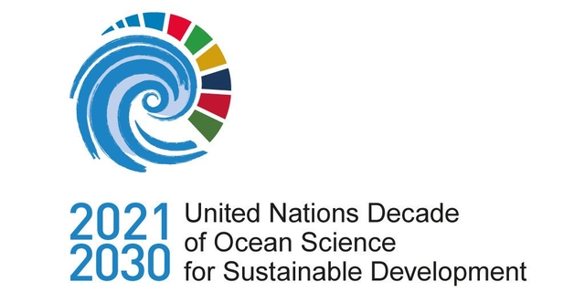

Rationale MSR Action Plan
IOC-UNESCO consulted
Inputs reflected in ISA MSR Action Plan
MoU, 2000
On-going cooperation
ISA contributed to all stages of planning phase of UN Decade
Notes:
The MSR Action plan was launched in 2020.
The fundament are embedded in two strategic ISA documents:
The Strategic Plans of the Authority for the period 2019–2023 (ISBA/24/A/10) and
High Level Action plan
Several strategic directions and actions and outputs have a direct relationship with the objectives of the MSR Action Plan.
What catalysed the creation of the MSR Action Plan was the decision of the UN General Assembly to declare the period of 2021-2030 to UN Decade of Ocean Science for Sustainable Development to foster scientific research and technological innovation in support of a healthier, more sustainable ocean.
This initiative is led by the Intergovernmental Oceanographic Commission of the UN Educational, Scientific and Cultural Organization (IOC-UNESCO).
The objectives of the Ocean Decade are at the core of ISA’s mandates.
Recognizing these synergies, ISA committed through the inception of the MSR action plan to collaborate more intensely with IOC-UNESCO.

Slide 7
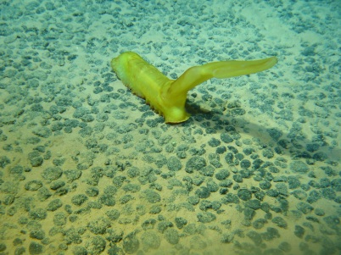
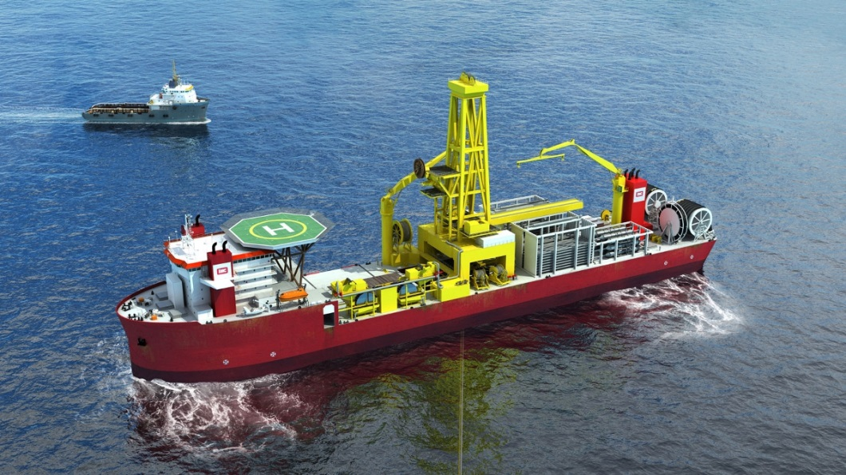
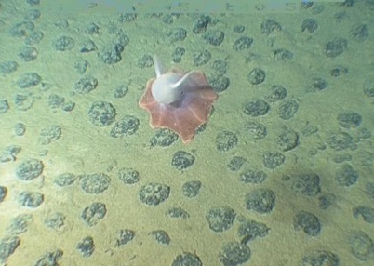
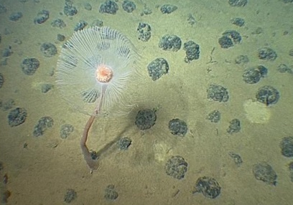
Polymetallic Nodule Exploration
$260 million on environmental studies
Notes:
Over the past 20 years, nearly 90 cruises in CCZ
Investment across the various regions,

Slide 8
Strategic research priorities
SRP1
Advance knowledge of deep-sea ecosystems
Yearly progress report (ISBA/26/A/25)
Funded by internal & external budget
SRP IV to increase through decisions of Council
SRP6
Strengthen deep-sea scientific capacity
SRP2
Standardize methodologies for biodiversity assessments
Strategic research priorities
SRP5
Promote scientific data sharing and deep-sea literacy
SRP3
Sound technological innovations
SRP4
Understanding environmental impacts
Notes:
Report of the Secretary General ISBA/26/A/25
Implementation of the Action Plan of the International Seabed Authority in support of United Nations Decade of Ocean Science for Sustainable Development
Refer to achievements in 2022
Highlight under SRP IV
Establishment of intersessional expert group on binding environmental thresholds
Independent study on the internalisation of environmental cost of exploitation activities in the production cost of minerals from are
Highlight outreach remains a key priority: hiring marine communication specialist
Highlight IFREMER has also played a key role supporting training and professional development of scientists from developing countries. For example, one of the most recent initiatives, the post-doctoral fellowship of Dr. Radhakrishnan Ranju whose research contributes to advancing deep-sea taxonomy is a testament of the productive partnership of France with ISA.

Slide 9






New
Knowledge
Data
Sharing
Integrative
tools
Innovating Global Scientific Collaboration to Advance Our Understanding of Deep-Sea Biodiversity
Uptake of
Science
Capacity
Development
Notes:
The Sustainable Seabed Knowledge Initiative (SsKi) focuses on advancing the knowledge of deep-sea ecosystems and biodiversity as a means to create the enabling conditions to ensure effective protection of the marine environment
The Initiative aims to enable ISA to strengthen cooperation with all interested stakeholders to obtain, assess and disseminate quantitative and qualitative biodiversity data and information in an open and transparent manner
SsKi focuses on advancing the knowledge of deep-sea ecosystems and biodiversity as a means to create the enabling conditions for the effectively fulfilling ISA’s environmental mandate, and in accordance with agreed international goals and objectives.
Generating new knowledge on deep-sea biodiversity and producing biogeographic and phylogeographic maps to assess evolutionary history, connectivity and resilience of deep-sea ecosystems
Unlocking biodiversity knowledge of the seabed through integrative and innovative tools that improves the consistency, efficiency and reusability of scientific information collected in the Area;
Building a global network of deep-sea taxonomists and centres of excellence;
Innovating the generation and flow of taxonomic data, including the enhanced data availability, accessibility and interoperability; and
Delivering data products that will strengthen scientific and technical capabilities of ISA and its stakeholders to support the implementation of the Mining Code including environmental planning, monitoring plan and risk/impact assessments.
Generating new knowledge on deep-sea biodiversity and producing biogeographic and phylogeographic maps to assess evolutionary history, connectivity and resilience of deep-sea ecosystems
Undertake integrative (molecular and morphological) taxonomic work using existing samples and new samples collected by contractors from contract areas by building a partnership framework with contractors and relevant scientific groups
Combine novel biological data with newly available bathymetry, including but not limited to, information to be produced by GEBCO 2030 Project
Compile diversity, distribution and phylogeographic to assess evolutionary history, connectivity and resilience of deep-sea ecosystems
We have set a target of increasing the number of species described by at least 1000 species by 2030 based on the recent rate of publications, but this number can be exceeded with greater cooperation and collaboration.
Unlocking biodiversity knowledge of the seabed through integrative and innovative tools that improves the consistency, efficiency and reusability of scientific information collected in the Area;
Produce regional lists of taxa and identification guides in different formats and tools targeting different types of users
Assemble genomic sequence information for species identification and develop metabarcoding and eDNA approaches
Compile image library for taxonomic identification and develop machine learning methods
Develop standard operating procedures for observation platforms and sampling equipment being used to explore and monitor the deep sea, especially in areas being explored for mining or associated APEIs
Innovating the generation and flow of taxonomic data, including the enhanced data availability, accessibility and interoperability;
Manage data entry and quality control (data curation)
Establish standards to allow interoperability of data flow between multiple archival systems, including sampling metadata, voucher material, sequences, images, occurrence data
Establish partnership with global data interface such as OBIS, as contribution of ISA database to global goals and targets of ocean management
DeepData dashboard as the key tool to measure the state of deep-sea ecosystems
Building a global network of deep-sea taxonomists and centres of excellence;
Establish exchange programmes and training workshops for taxa-specific identification skills
Establish centers of excellence on deep sea taxonomy for sample processing, including sorting and preparation of specimens for identification, in partnership with relevant regional institutions/programmes
Equip centers with appropriate facilities to support sorting, para-taxonomy, and storage of deep-sea specimens, and initial extraction of DNA from tissue samples
Delivering data products that will strengthen scientific and technical capabilities of ISA and its stakeholders to support the implementation of the Mining Code including environmental planning, monitoring plan and risk/impact assessments.
Provide credible, objective and defensible guidance on the location and configuration of a collection of APEIs or other areas to maintain species meta-populations, habitat integrity and ecosystem services across a broad range of spatial and temporal scales
Contractors using the best practices
Standardized approach among contractors to conduct environmental baseline studies
Data gaps filled to inform the ISA process

Slide 10
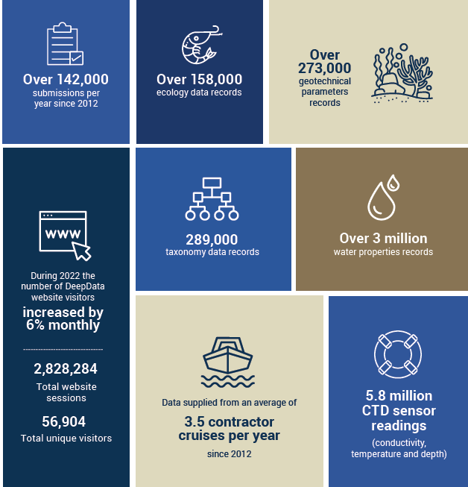
ISA DeepData (http://data.isa.org.jm)

Slide 11
Marine genetic resources (Part II of the BBNJ Agreement) - ISA Deep-sea Biobank Initiative
Global access to deep-sea biological samples and genetic data for advanced scientific research and capacity-development.
Standard operating Procedure (SOP)
ISA DeepSea BioBank
Capacity Development
Notes:
While regulating access to marine genetic resources does not directly fall under the competence of ISA, various elements of ISA’s work interface with related provisions of the BBNJ Agreement. ISA contributes to Knowledge generation and technology transfer.
SSKI increase the knowledge through the description of new species. This information will support the clearing house mechanism in BBNJ.
Collecting and studying biological samples from the Area and the derived data, are key to environmental baseline studies, monitoring and impact assessment processes under both ISA and the BBNJ Agreement.
Initiative:
Launched at UNOC-III last month, this initiative aims to facilitate access to valuable deep-sea biological samples and genetic data for advanced scientific research and capacity-development activities.
Three components – title is access (call in SSKI also connecting to contractors collections and also management of those collections)
ISA exploration regulations require contractors to collect, study and share biological samples and data, which ensures a robust regulatory regime for activities in the Area informed by the best available science – Contractors well received
Decades of contractors' activities have collected over 750,000 biological and geochemical samples, which will continue to grow.
Facilitating access to such samples and data also constitutes ISA’s effort towards equitable sharing of benefits derived from activities in the Area as mandated by UNCLOS.
One of ISA's flagship initiatives for MSR and capacity-building, but it will also bridge the cooperation with the BBNJ.
1/ SOP
Sampling, processing, sharing.
Enhance data quality, comparative & regional analyses.
Facilitate research collaboration.
Recommendatory & adaptive nature.
2/ BioBank
Hosted in the Republic of Korea.
Equitable and fair access to samples facilitated by ISA.
Voluntary sharing of samples
3/ Research & capacity-development programmes
Training courses, fellowships, workshops etc.
Priority knowledge needs of ISA.
Research cooperation at the institutional level.
Data standardization & sharing.
Cooperation with BBNJ:
Research collaboration and capacity-development activities through the Biobank will be a model example of efforts to increase access to deep-sea biological resources, which can be reinforced by the implementation of the BBNJ Agreement.
SOPs will contribute to enhancing deep-sea research beyond ISA work.
Will closely collaborate with the BBNJ Secretariat.
Next steps:
Draft SOPs to be prepared to inform an expert workshop in 2026.
Resource mobilization:
The Initiative has been widely welcomed by member states, contractors, private entities, and media). We are discussing partnerships and would welcome other to join the kick start.
Encourage all to contribute financial resources and expertise to support the activities.

Slide 12
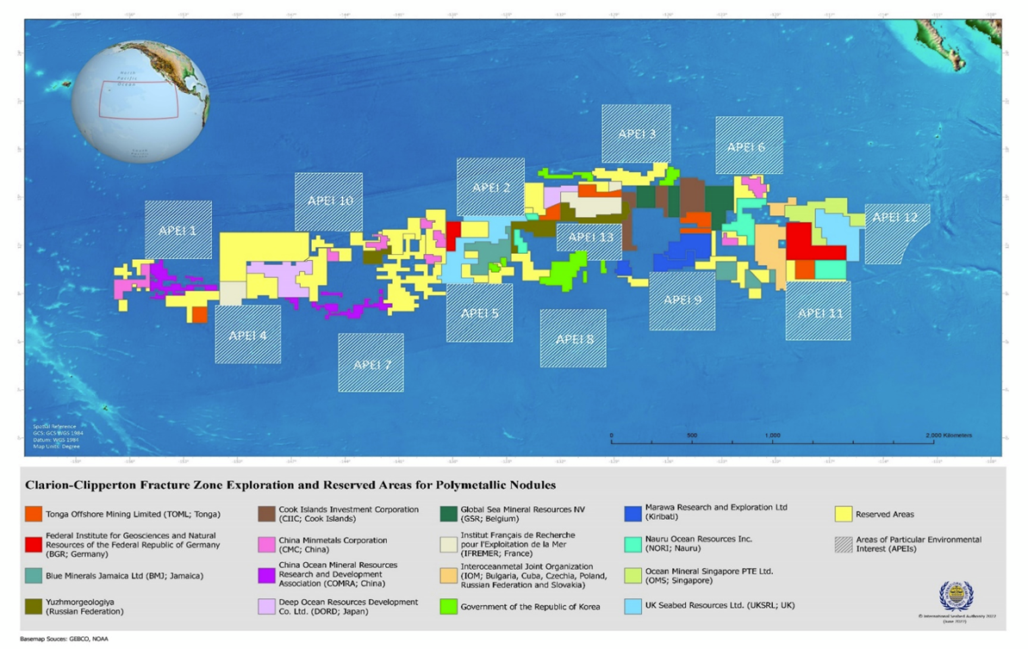
Area-based management tools (Part III of the BBNJ Agreement) - REMP
Science based process
Produces data gathering and analysis
Results: environmental goals and objectives; areas set aside from future mining;
Notes:
ISA is mandated to take necessary measures to ensure effective protection for the marine environment from harmful effects which may arise from activities in the Area. To this end, ISA has adopted and developed regulations, recommendations, and tools, including area-based management tools (ABMTs).
An ABMT is generally defined as a geographically defined area through which human activities are managed with the aim of achieving particular conservation or sustainable use objectives, which includes, but not limited to, marine protected areas.
REMPs are developed through a transparent and science-based process involving over 500 experts (open nomination) and 8 expert workshops since 2018. It uses globally adopted scientific criteria (CBD EBSA criteria and FAO VME criteria), in the context of ISA – RFMOs and cables invited – MANY OF YOU HAVE NOMINATED AND YOUR EXPERTS PARTICIPATED
Standarised approach approved
Led by LTC
Science (data and knowledge available)+ Management + political decision
ISA has protected nearly 2 million km² in the Clarion-Clipperton Zone through REMP and additional REMPs are being developed (review every 5 years)
REMPs are also playing a role in facilitating the collaboration among and between ISA contractors and scientists, by identifying the research priorities and areas where survey efforts are needed, as in the case of the environmental management plan for the CCZ.
Needs:
Need for exchanges of data, knowledge and experiences in planning exercises
Need for standarisation of in methods for collecting environmental data, and in metadata for databases

Slide 13
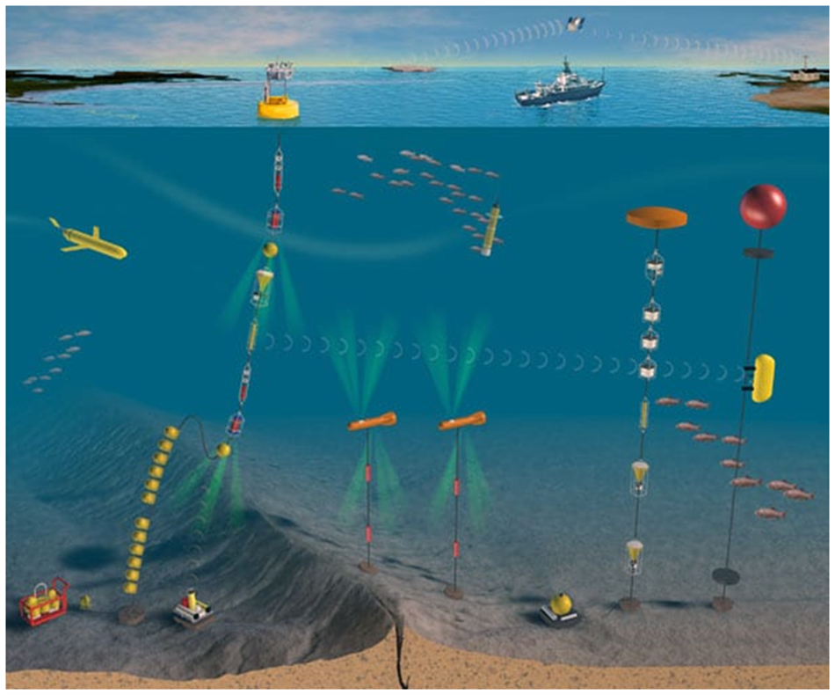
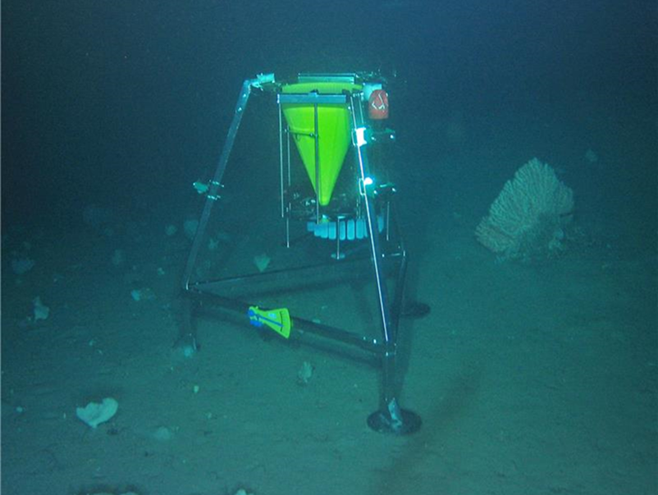
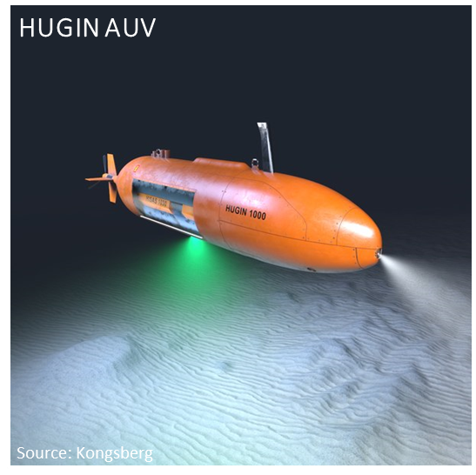
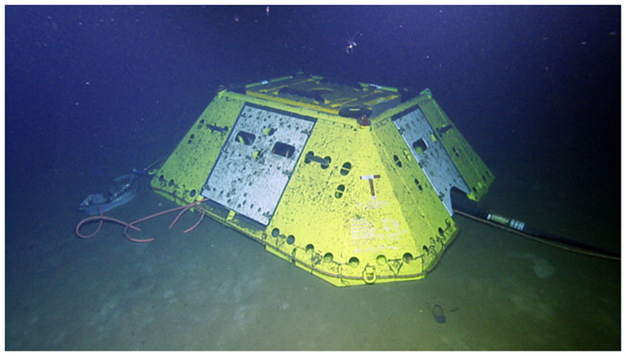
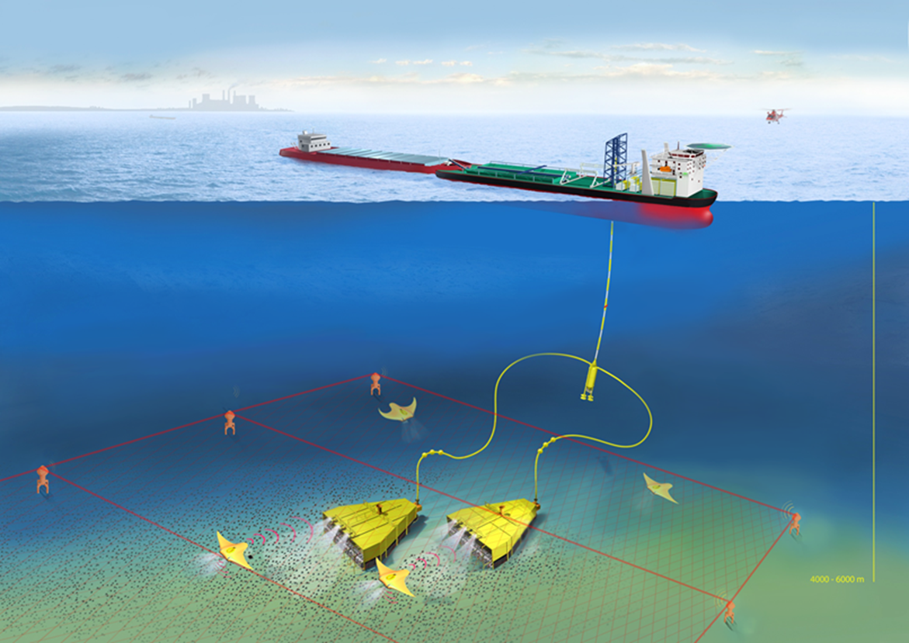
ISA Draft Technology Roadmap – Areas of Priority
Ocean Observation and Communication
Monitoring
Autonomy, Automation, Robotics
Machine Learning and Artificial Intelligence
Mining, Energy and Metal Processing
Source: Woods Hole Oceanographic Institute
Source: DNV
Source: www.oceannetworks.ca
Source: EvoLogics

Slide 14
Scientific support to ISA’s regulatory process
Facilitate ISA’s science-policy interface
Support the work of the Legal and Technical Commission (LTC)
  5-year workplan
  REMP process
  Environmental thresholds
  Internalization of environmental costs
  Review of contractors reports and EIAs
Secretariat
LTC
Council
Notes:
Facilitate ISA’s science-policy interface
OEMMR → LTC → Council decisions
OEMMR supports LTC by preparing technical and scientific information/data as required by LTC workplan provided by the Council.
Organizing REMP workshops, managing consultancies and organizing results for LTC discussions
Support 41 members elected for the period 2023-2027 as the Deputy Secretary to LTC
The Council is advised by the Legal and Technical Commission for legal and scientific input.
OEMMR manages and facilitates scientific processes in support of LTC’s recommendations to the Council for informed decision-making

Slide 15
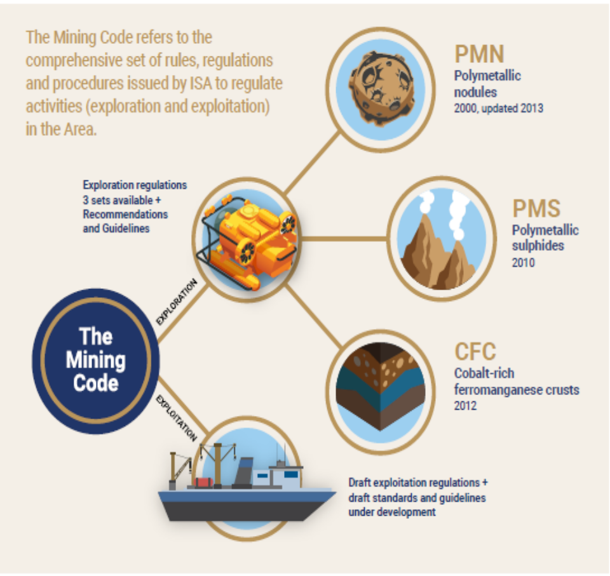
Environmental management for activities in the Area
The Mining Code
Recommendations, draft standards and guidelines for Environmental impact assessment and baseline data collection
Regional Environmental Management Plans (REMPs)
Notes:
ISA is in the process of drafting regulations for future exploitation activities, and has prepared draft standards and guidelines for EIA, collection of baseline data and environmental management systems.
In addition to the legal framework, there are REMPs, which are policy instruments established to manage potential environmental impacts at a regional scale. REMPs establish goals, objectives and measures for environmental management, including through the identification of areas or sites that are in need of protection.

Slide 16
Future outlook
New research domains that are on the global agenda
  Microplastics, Ocean health
Creating even bigger impact
  Enhancing the science-policy interface more through policy briefs
Enhancing synergies with the contractors
Launch of the Partnership Fund (ISBA/27/FC/3)
Notes:
Data Strategy Outcomes for the Period 2017-2022
Completed Data Audit
Launched DeepData Website
Strategic Partnerships for Data Sharing
Revised Reporting Templates

Slide 17
Thank you

