Slide 1
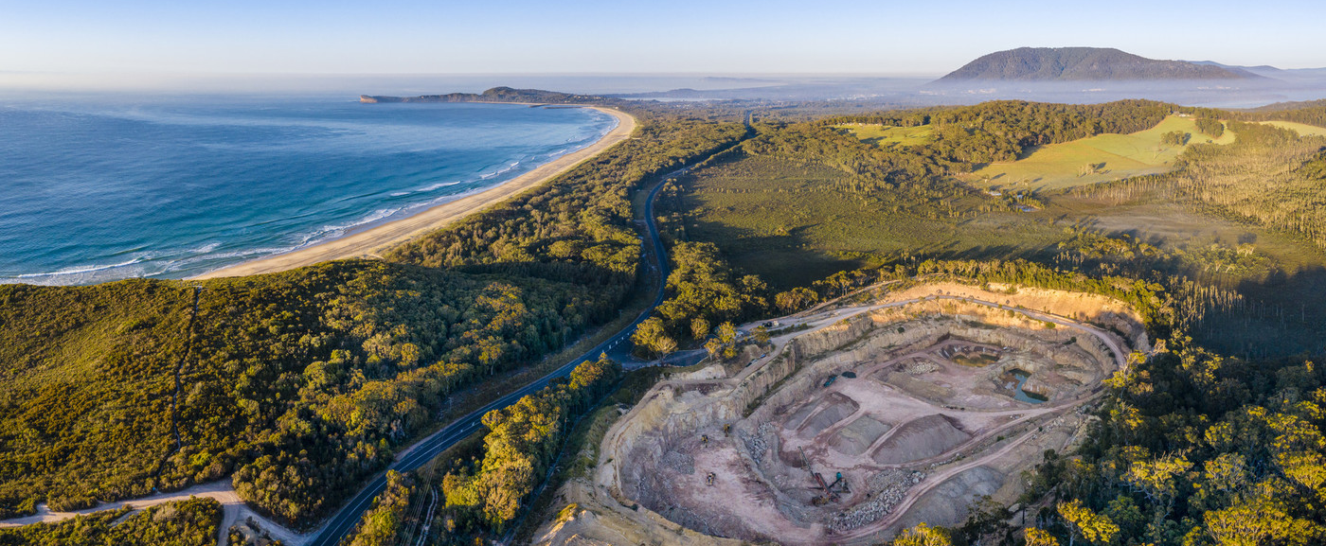
Key Findings from IGF Draft Report on Payment Regimes for Deep Sea Mining
Date: 15th March 2023

Slide 2



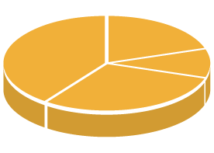





How do we help governments?
IN-COUNTRY ASSESSMENTS
CAPACITY
BUILDING
TECHNICAL ASSISTANCE
A VOLUNTARY INITIATIVE
CREATED THROUGH
THE UN IN 2005
79 MEMBER
COUNTRIES
GUIDANCE FOR GOVERNMENTS
EVENTS & CONFERENCES
DEDICATED TO IMPROVING MINING GOVERNANCE TO HELP ACHIEVE THE
UN SUSTAINABLE DEVELOPMENT GOALS.

Slide 3
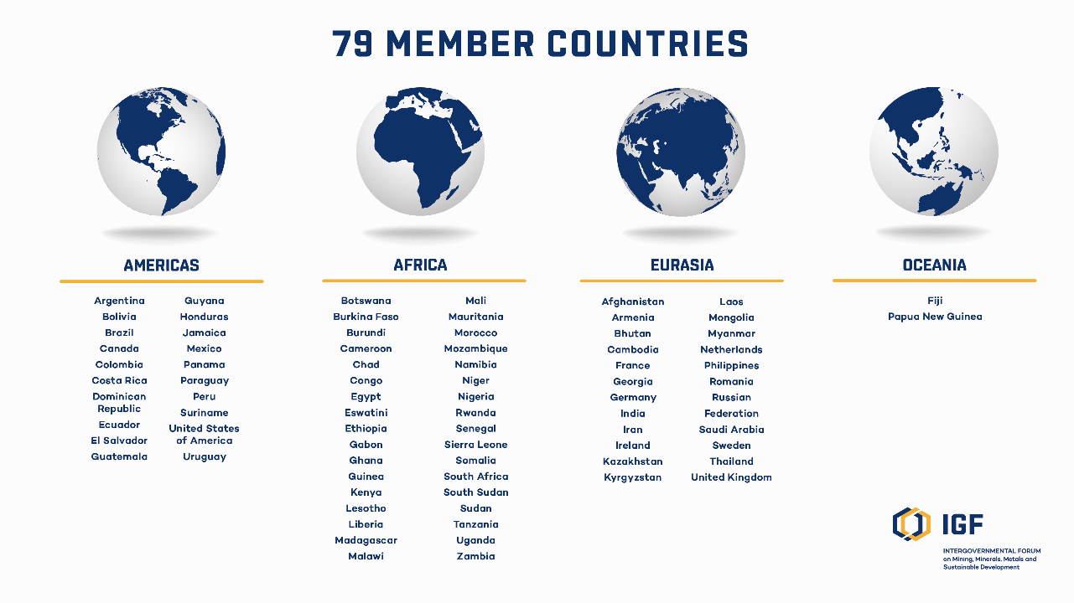

Slide 4

Assessing the Four Payment Options

Slide 5
The ‘Government Take’
Bonus
Revenue from sales
Royalty
Gross revenue
Pre-tax profit
Production Cost (inc. debt)
Income tax
Resource
rent tax
Indirect taxes
on inputs
(import duties, VAT, etc.)
After-tax profit
State
equity
Investor’s dividend
Withholding
tax
Dividend (minus
withholding tax)
Government revenue
Investor’s return
Source: NRGI

Slide 6
The Average Effective Tax Rate
Total government returns
Total pre-tax cashflows

Slide 7
Principles for mining fiscal regime design
Overall goal: maximise revenues from DSM for the benefit of humankind
Neutrality
      What is an appropriate IRR for DSM?
        MIT model uses 17.5%; IMF FARI Model uses 12.5%
        DSM is risky, but rate should decrease over time – justification for a dynamic IRR
Progressivity (next slide)
      Especially important for critical minerals
      Chasing prices is not sustainable. Need a flexible system that automatically adapts to changes in profitability.
Simplicity
      Particularly important considering the time it will take to build up the ISA’s tax administration capabilities.
  Stability
      Fiscal stabilization ≠ equal stability. Regime must be financially and politically sustainable.
Robustness to profit shifting
Timing of revenues
      Less sensitive for DSM than LBM,.
Notes:
Furthermore, whereas land-based miners must build unique infrastructure for each deposit, seabed miners can move to the next mine relatively quickly once the ship/system is built, offering further justification for using a lower, or at least a dynamic, IRR

Slide 8
Progressivity (of profit-based taxes)
A progressive fiscal regime imposes higher level of taxes as profits increase (and regressive imposes higher level of taxes as profits decrease)
Progressive
Tax
burden
Regressive
Profits
Notes:
Refers to how the tax burden responds to changes in profitability (e.g. progressive personal income taxes charge higher rates on higher incomes)
A progressive mining fiscal regime would impose a higher tax burden when profits are high, and a lower tax burden when profits are low or negative
A regressive mining fiscal regime would impose a lower tax burden when profits are high, and a higher tax burden when profits are low or negative
Progressive fiscal regimes are usually preferable to investors and governments
For investors, it reduces taxes on marginal profits and therefore distorts investment decisions less
For governments, it gives a larger share of benefits from highly-profitable projects arising from the intrinsic value of the mineral resource (rents)
In practice mining fiscal regimes tend to be regressive at low/zero profits and less progressive at high profits than they could be

Slide 9
IGF Financial Model
Key assumptions underpinning the IGF model
Revenue and royalty base: the gross value of the contained metals—copper, nickel, cobalt, and manganese (valued with reference to manganese ore)
CIT rate in sponsoring state = 25%
Processor IRR = 50% * 10% + 50% * contractor IRR
0-10% WHT on interests, dividends, and 50% of operating services
60% debt financing from build and design phase
NOTE: Price and costs assumptions have been updated. As a result, DSM appears more profitable and the AETRs of each option look different than under earlier estimates. The OEWG will need to update the rates of payment (other than Option 3) to achieve a theoretical AETR of 47% under the new assumptions.
Notes:
Financing - MIT model uses 100% equity
Prices - Same price assumptions except that we index to inflation rather than using a Monte Carlo simulation. Difference is relatively insignificant.
Depreciation - MIT uses capital carryover method to integrate capital expenses. IGF uses straight line depreciation – more neutral considering that SS may have different approaches.
Profit share – we model based on cashflows rather than accounting profits. Simpler to administer, less vulnerable to avoidance.
Processor IRR – MIT sets the processor IRR the same as the contractor IRR. This reflects the fact that processors will assume a lot of risk / have a lot of bargaining power at the start, hence profit splits may be necessary. While this may be true for first movers, it will change over time as more refineries are built. The way processors are compensated has a material impact on contractors cashflows i.e., as the cost of processing decreases, tolling arrangements are likely to emerge (fee for service). The result is that contractors will be left with more of the profits, potentially lowering their AETR. This underscores the need to design a fiscal regime that can accommodate first movers without building big giveaways into the regime.
Updated price/ costs - This is an endorsement of our focus on sensitivity analysis when looking at AETRs. It also highlights the need for a flexible fiscal regime that accommodates changes in profitability.

Slide 10
Quantitative Comparison of the Four Options
Based on IGF Financial Model
Participant cashflows % | Option 1 | Option 2 | Option 3 | Option 4
ISA % | 14.9% | 16.1% | 24.1% | 14.6%
Sponsoring state % | 21.3% | 21.0% | 23.3% | 21.4%
AETR (ISA and sponsoring state combined) | 36.2% | 37.1% | 47.4% | 36.0%
Contractor % | 62.3% | 61.4% | 51.1% | 62.5%
Loan provider % | 1.4% | 1.4% | 1.4% | 1.4%
Contractor IRR (real term CF) | 22.2% | 22.6% | 21.1% | 22.7%
Notes:
Evert payment regime option except Option 3 produces a lower AETR than the target AETR of 47%. Due to changes in price/ cost assumptions + lack of flexibility.
Even under revised assumptions, Option 3 achieves a higher AETR for the ISA while also achieving a reasonable return for investors. This is because unlike the other options, it includes a profit share. Whereas a royalty is relatively easy to administer and provides early, predictable revenue, a profit share captures an important share of profitable businesses while sparing loss-making entities, thereby encouraging investment and economic activity.

Slide 11
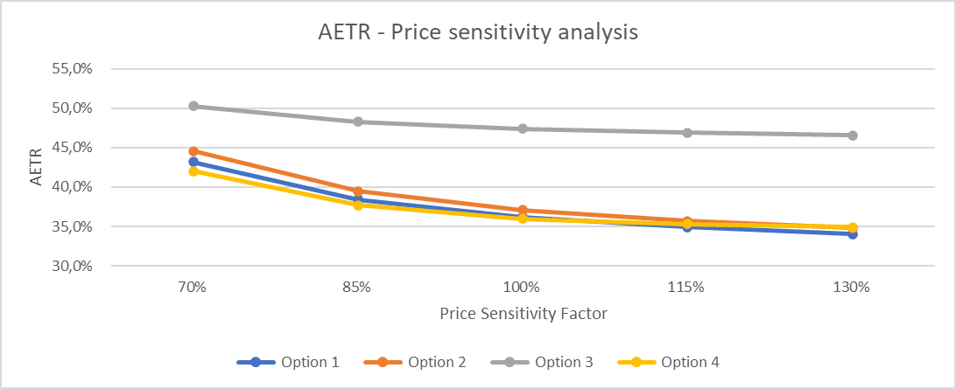
Notes:
Option 3 most progressive.
Option 4 less regressive than 1 and 2 – to be expected because it is designed to respond to changes in price.

Slide 12
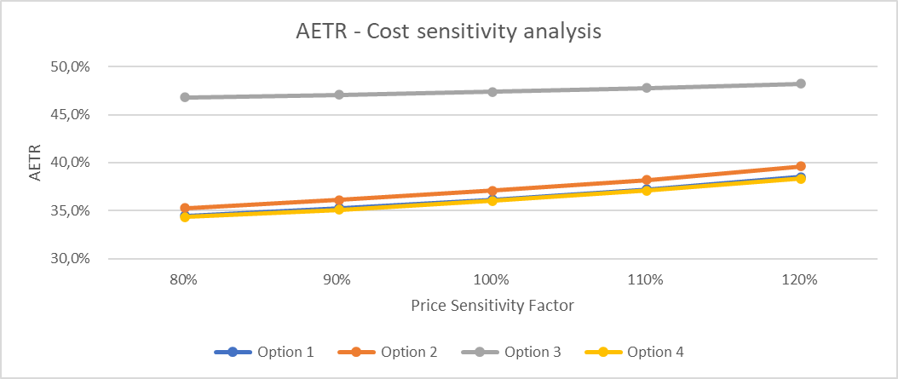
Notes:
However Option 4 is equally regressive as 1 and 2 with respect to changes in cost.
Option 3 most progressive because profits take into account changes in cost.

Slide 13
Qualitative Comparison
Options | Advantages | Disadvantages
Option 1: Fixed rate | Easier to administer (e.g., no need to monitor price to determine rate). Lower compliance costs. Revenue stability. | Government take would not adjust to reflect changes in profitability.
Option 2: Variable rate (time period) | Less regressive than a fixed-rate royalty (depends on time-profit correlation). Easier to administer than Option 4. | Cliff edges would make it vulnerable to abuse, e.g., high-grading. Less progressive than Option 4.
Option 3: Variable rate (price-based) and profit share | Combines an early, predictable source of revenue with a share of the profits. Most progressive option. Profit share due when a contractor is making profits. | Profit share may be complex to administer depending on design. Revenues may be delayed. Vulnerable to profit-shifting, particularly with respect to costs.
Option 4: Variable-rate royalty (price-based) | ISA’s revenue would increase automatically when prices rise. Easy to communicate to the public; royalties increase with prices. Sensitive to a company’s profitability, assuming profits track prices. | More complex to administer; prices must be monitored to determine the rate.

Slide 14
Understanding the Interaction Between the Four Payment Options and Sponsoring State Taxes

Slide 15
Understanding the impact of Sponsoring State taxes
We model three scenarios for Options 3 and 4:
Full taxation: 25% CIT and 10% WHT on services, interests, and dividends
Half taxation: 12.5% CIT and 5% WHT on services, interests, and dividends
No taxation: 0% CIT and 0% WHT on services, interests, and dividends
Notes:
AG raised concerns about low CIT in SS. CIT exemptions not the only concern. Likely to offer low or zero WHT in the agreements, or via DTAs etc.

Slide 16
Low or zero taxation in sponsoring states has a big impact on the AETR
Participants share under Options 3 and 4
Notes:
Narrow down the focus to Options 3 and 4, particularly 4 considering the growing consensus.
This shows that when the rate of sponsoring state taxes decreases, the contractor shareholder’s share of total revenue increases significantly, especially for Option 4. The sponsoring state’s share decreases all the way to 0%,

Slide 17
An equalisation measure is necessary to ensure all contractors have a similar AETR
Two options proposed so far – others may follow
Additional Royalty (African Group)
  6% of gross revenue
  Kicks-in five years after commercial production starts
  Contractors can deduct CIT paid to their sponsoring state in the previous year
Profit share
  Additional profit share based on contractors’ cumulative pre-tax cashflow
    Immediate expensing of CAPEX i.e., no depreciation
    No deductions for interest expense – accounts for cost of capital using uplift on negative cashflows
  Contractors can deduct CIT paid to their sponsoring state in previous years

Slide 18
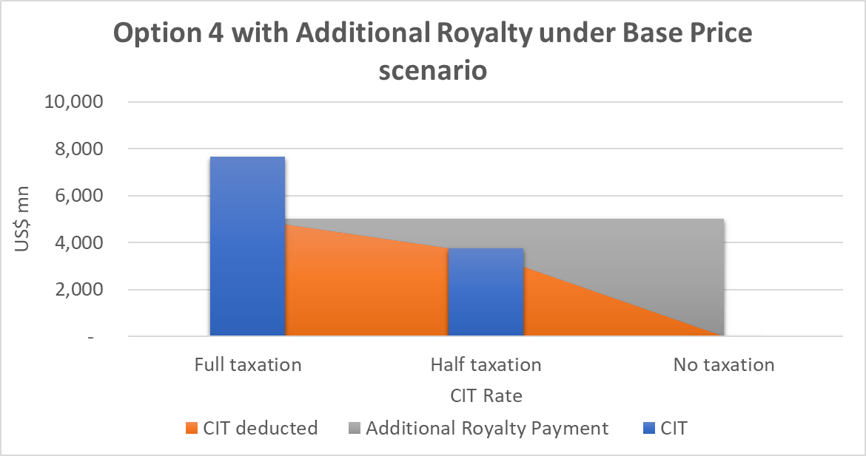
Additional Royalty – how it works
Notes:
If a contractor pays a CIT rate of between 20 and 25% in the sponsoring state, it should be able to credit all its CIT payments toward this additional royalty and will not pay any additional royalty. However, as the contractor pays less CIT in the sponsoring state, it will have less CIT to credit against the ISA’s additional royalty, and it will pay more additional royalty. This aims to remove any financial incentive to secure a low CIT rate or CIT holidays in sponsoring states.

Slide 19
Additional Royalty – pro’s and con’s
Advantages:
Simple to administer – although may become more complex if more taxes are included.
Based on information the ISA should already have: price, quality, and quantity of nodules
Challenges:
Some contractors may have a comparable AETR over the life of the project, but pay no tax in the early years of production due to cost recovery, and capital allowances in sponsoring states. Consequently, there may be no tax to offset the additional royalty, leading to a lower IRR.
A royalty is a regressive fiscal instrument – next slide.
May be financially unsustainable for contractors, generating calls for renegotiation of the regime.

Slide 20
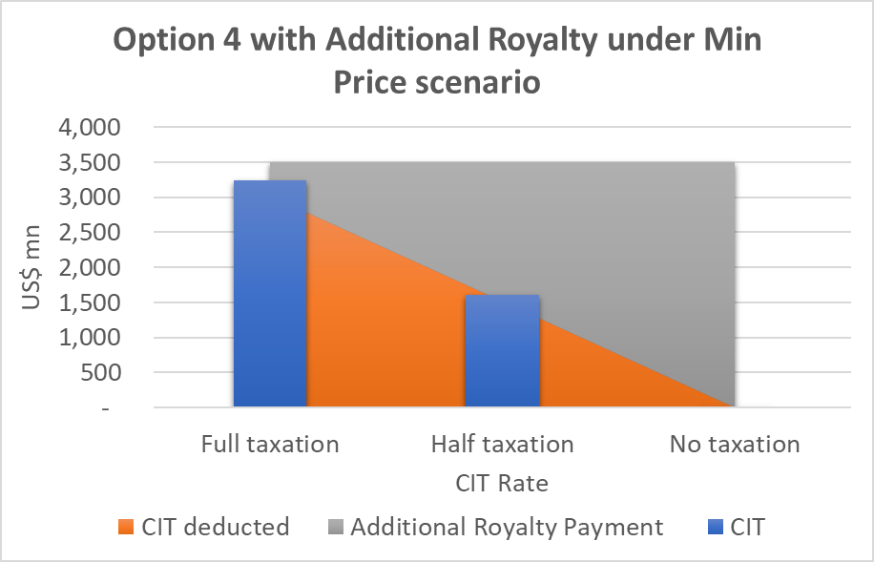
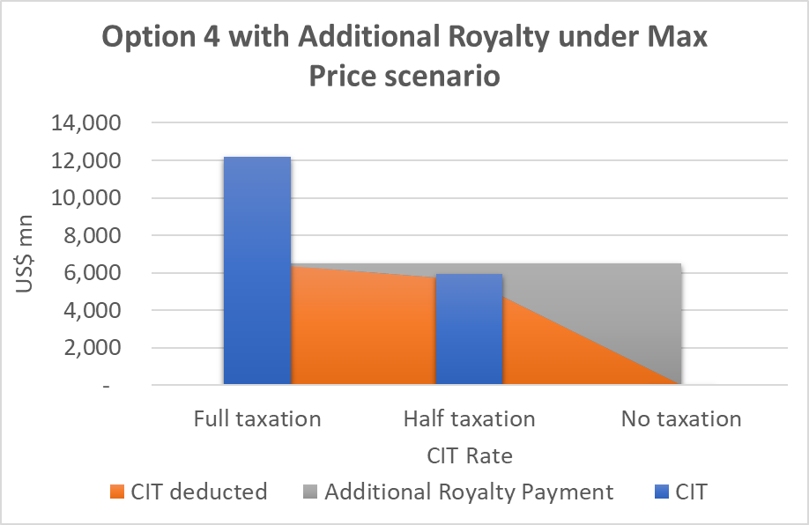
Additional Royalty – sensitivity analysis
  Low profits = lower tax = less CIT to credit against royalty
  Contractor pays an additional royalty to the ISA over and beyond their CIT payments to the sponsoring state, even if they are paying a full 25% CIT rate.
  Higher profits = higher tax = enough CIT to credit against royalty, even if its CIT rate is much lower than 25%.
  Not fulfilling role as equalization measure.

Slide 21
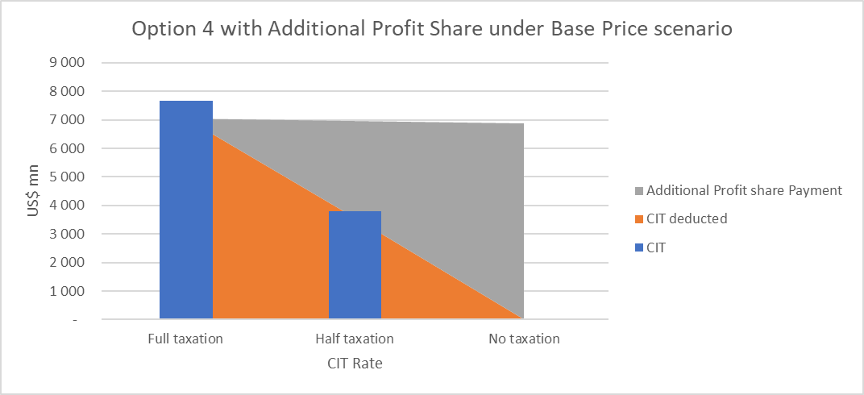
Additional profit share – how it works

Slide 22
Profit share slightly better than royalty at equalising
Participants share under Options 4b additional royalty and additional profit share

Slide 23
Additional Profit Share – pro’s and con’s
Advantages:
More efficient – next slide
Takes effect at the right time
Likely to be included in the calculation of ETR for the global minimum tax
Challenges:
Harder to administer – need to verify costs as well as revenues
More vulnerable to tax avoidance – specifically cost overstatement
ISA would need to audit costs
Potential double taxation

Slide 24
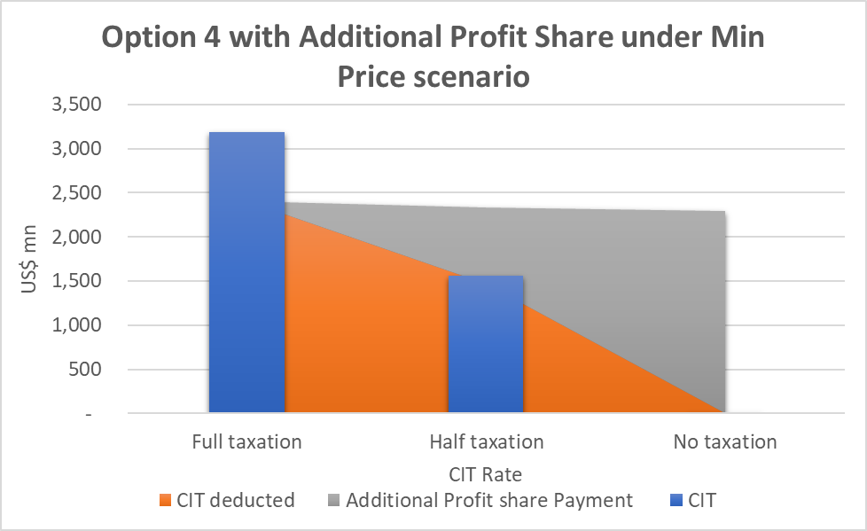
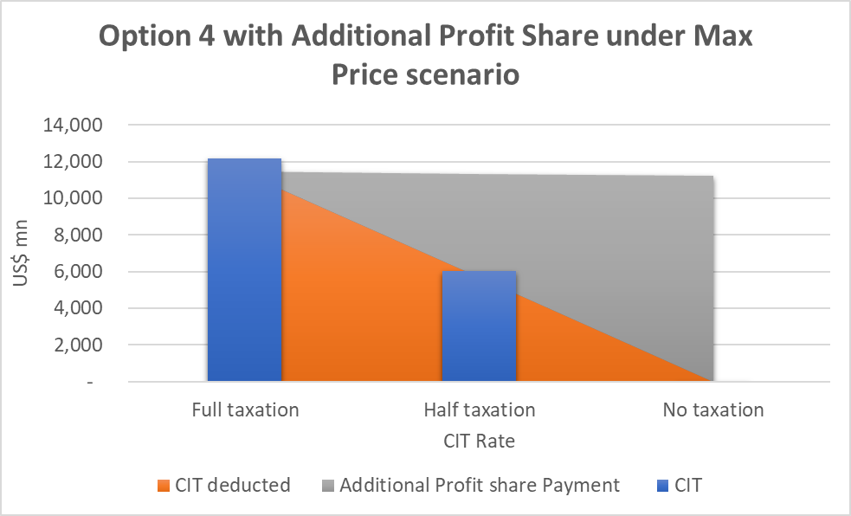
Additional profit share – sensitivity analysis
No additional payment as long as the rate of tax in sponsoring states is at 25%, regardless of market conditions.
CIT in the sponsoring state would normally be paid before a profit share based on cash flows, which will allow contractors to carry forward any CIT payment to credit against the additional profit share.

Slide 25
Additional profit share – administrative challenges
Hard to administer / easy to avoid
Cashflow basis eliminates depreciation charges and interest expense
Related party loans biggest source of profit shifting in the sector
Audit capacity
Technical assistance / capacity building
Tax Inspectors Without Borders program – direct audit assistance
Also necessary for tax on transfers
Double taxation
Many countries provide unilateral double tax relief
Double tax relief could be included in the ISA Mining Code

Slide 26
Taxation of Transfer of Rights / Assets

Slide 27
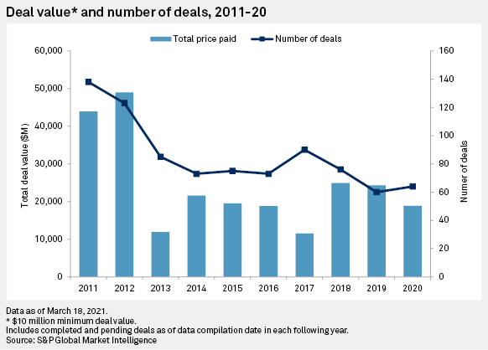
MERGERS AND ACQUISITIONS ARE A KEY PART OF THE MINING INDUSTRY
Notes:
https://www.spglobal.com/marketintelligence/en/news-insights/blog/mining-ma-in-2020-deal-activity-bounces-back-in-h2-after-disrupted-h1

Slide 28
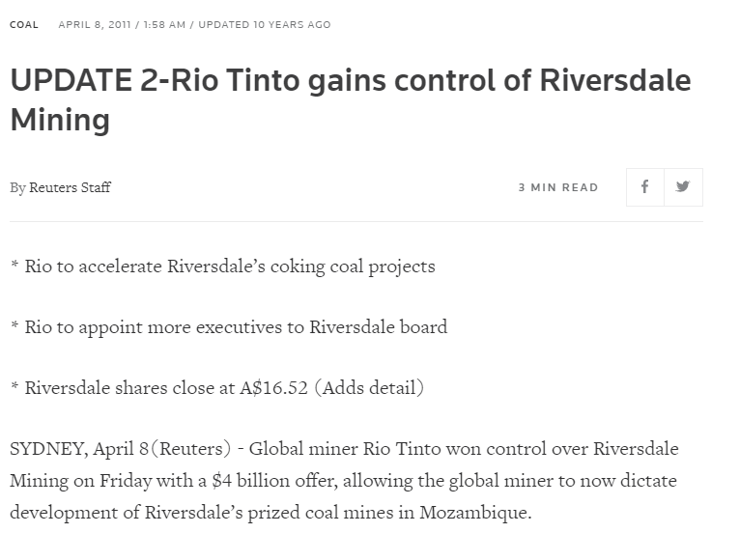
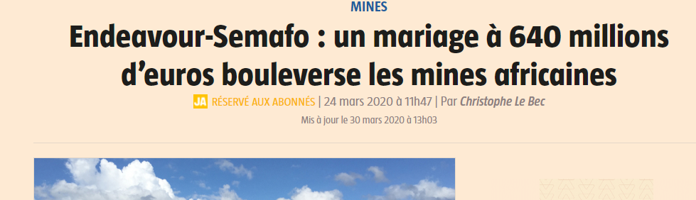
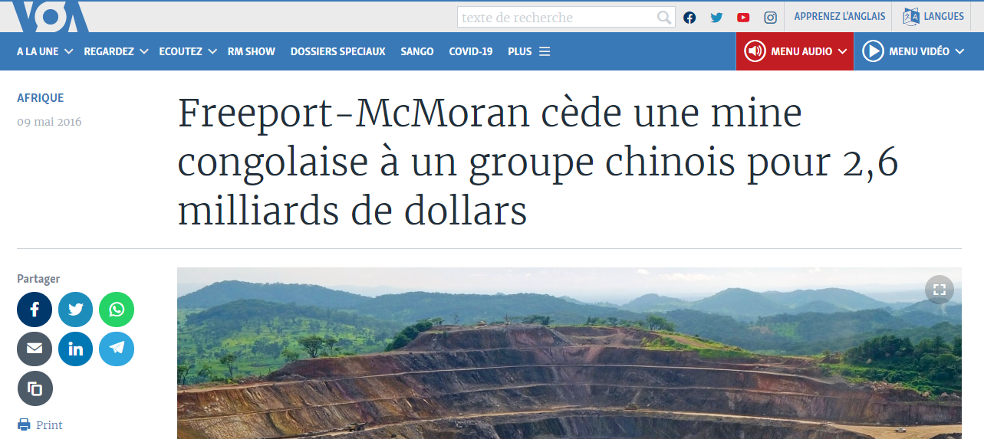
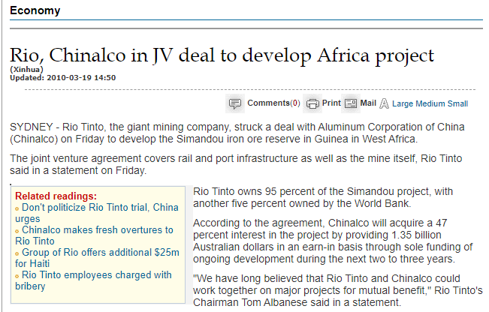
AND CAN LEAD TO LARGE GAINS

Slide 29
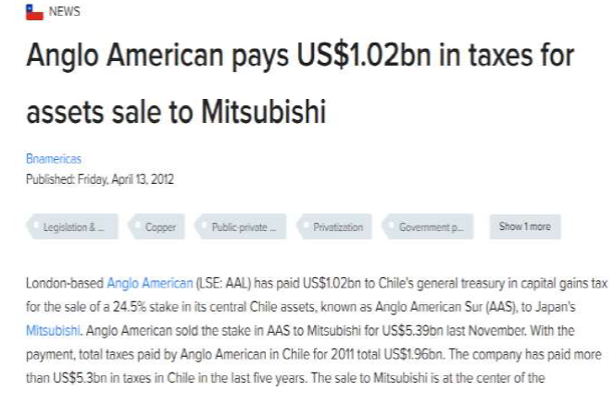
SOME OF THOSE GAINS ARE TAXED BY HOST COUNTRIES
E.g., Anglo American – Mitsubishi 2012 sale in Chile

Slide 30





ILLUSTRATION: ACQUISITION OF MASSAWA GOLD MINE, SENEGAL (2020)
BARRICK GOLD CORP
TERANGA GOLD CORP
Canada
US$380M
SUBSIDIARY
JOINT VENTURE
Joint Venture Partner c
SUBSIDIARY
Sale of subsidiary *
Jersey *
Senegal
90%
Jersey *
10%
MASSAWA GOLD PROJECT
GOVERNMENT
(*) Although the domicile of the subsidiary was not disclosed in the press releases, by reviewing the corporate structure of both groups, we believe that the target entity was domiciled in Jersey.
Notes:
Suggested reading material:
https://www.pressafrik.com/Le-Fisc-senegalais-peche-un-poisson-dore-dans-le-sous-sol-Barick-Gold-doit-cracher-120-milliards_a231323.html
https://www.dakaractu.com/Exclusif-Mark-Bristow-President-et-directeur-executif-de-Barrick-Gold-Corporation-Pourquoi-nous-contestons-le_a202923.html
***
Sénégal Code Général des Impôts (2012, as amended in 2019)
Article 4. I. Les sociétés anonymes et les sociétés à responsabilité limitée, à l’exclusion de la société unipersonnelle à responsabilité où l’associé unique est une personne physique, sont soumises à l’impôt sur les sociétés.
II. Sont également soumises audit impôt:
1. les sociétés civiles, quelle que soit leur forme, lorsqu’elles se livrent à une exploitation ou à des opérations présentant un caractère industriel, commercial, agricole, artisanal, forestier ou minier (...)
5. les personnes morales domiciliées à l’étranger lorsqu’elles sont bénéficiaires de revenus fonciers au Sénégal ou de plus-values provenant de la cession d’immeubles sis au Sénégal ou de droits y relatifs ou réalisent des plus-value à la suite de cessions de valeurs mobilières ou de droits sociaux détenus dans des entreprises de droit sénégalais.
Article 49. 1. Sont considérés comme revenus de source sénégalaise: (...)
e. les profits tirés d'opérations définies à l’article 118, lorsqu'ils sont relatifs à des fonds de commerce exploités au Sénégal ainsi qu’à des immeubles au Sénégal, à des droits immobiliers s’y rapportant ou à des actions et partes de sociétés dont l’actif est constitué principalement par de tels biens et droits.
Article 556. La plus-value acquise par les terrains bâtis ou non bâtis, les droits relatifs aux mêmes immeubles et les titres miniers est soumise, en cas de cession des
dits immeubles ou droits, à une taxe dite "taxe de plus-value immobilière".

Slide 31
ISA’s right to tax the transfer of rights
Legal basis to tax profits arising from activities taking place in the Area
Annex 1 of the Implementing Agreement gives the ISA the option to choose a royalty system or combination of a royalty and profit-sharing systems.
  A capital gains tax represents a share of the profits arising from the sale or transfer of a mining right.
Section 8(1)(b) also requires that the rates of payment be within the range of those for land-based mining.
  Tax on the sale or transfer of mining rights is a feature of most land-based fiscal regimes. Not applying such a tax would give DSM a comparative advantage over land-based mining.

Slide 32
Common practice in land-based mining countries
The majority of countries tax capital gains (PwC, 2022).
The survey considered 151 jurisdictions
133 of which have rules in their legal systems to tax capital gains.
Many countries also tax offshore indirect transfers of mining assets
IGF has identified at least 27 that have a specific capital gains taxes for the indirect transfer of assets located in their territories. Many are resource-rich.

Slide 33



Common practice in land-based mining countries

Slide 34
Common practice in land-based mining countries
Two main models:
  Model 1 – taxation of a deemed direct sale by a resident
  Model 2 (most used) taxation of the non-resident seller
Parent Co
Intermediate
Co 1
Model 2
Taxation of Intermediate Co 1
Intermediate
Co 2
Location
Country
Local Asset Owning Co
(Mining right)
Model 1
Taxation of Local Asset Owning Co
34

Slide 35
Considerations on the African Group proposal
Tax base: gross versus net gains in a transaction?
Reduce threshold to encompass sales of shares when less than 50% of the value derives from assets located in the Area / pro rata taxation?
De minimis threshold: what is the right level to only exclude small transactions?
Definition of taxable assets and immovable property: including licenses themselves, as well as shares and similar interests in entities holding those licenses ?
Obligation to inform the Authority and update the license with regard to changes in the corporate structure or beneficial ownership? EITI requirements on disclosing beneficial ownership?
Add the sponsored entity as an additional liable person?
Anti-fragmentation rule: replace the reference to “the sole opinion of the Authority” with a fixed time period of one to five years, in line with international practice?

Slide 36


